Slide 1
PROJECT TITLE: DS²
SMART SYSTEM TO DETECT DISTRACTION AND SLEEPINESS USING OPENCV
TEAM MEMBERS:
KARTIKEYA GUPTA
NIKHIL GANGWAR
MAYANK GOYAL
DIVAKAR VERMA

Slide 2

PROBLEM STATEMENT
The Drowsy Driving Problem
Drowsy driving is a major problem . The risk, danger, and often tragic results of drowsy driving are alarming. Drowsy driving is the dangerous combination of driving and sleepiness or fatigue.

Slide 3
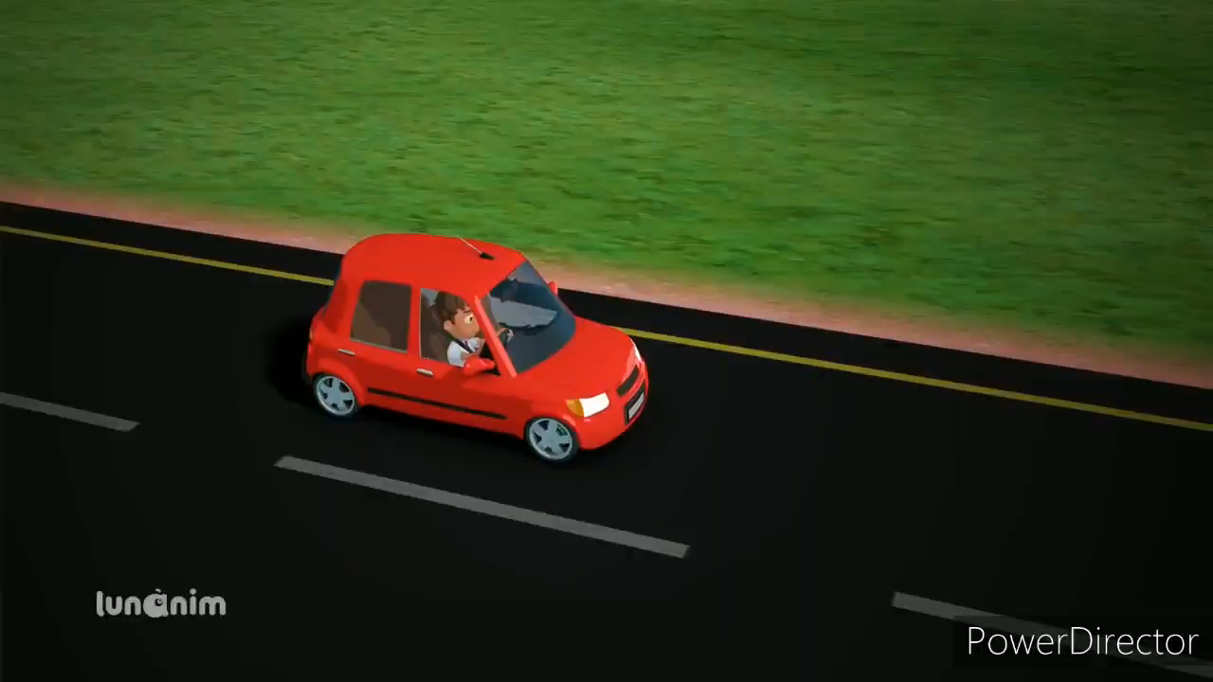
WHAT WE ARE TRY TO SAY

Slide 4
Did You Know?
According to the latest data released by road transport and highways , 1,47,913 people were killed in road accidents in 2019, with Uttar Pradesh reporting the maximum number of 20,124 road accident fatalities, followed by Tamil Nadu with 16,157 deaths.

Slide 5
IDEA/SOLUTION
There are several different algorithms and methods for eye tracking, and monitoring
Different Phases are:
Sensing Phase
Detection Phase
System Process
1-Eye detection function:
2-Binarization
3-Removal of Noise
CAMERA
START FOR REAL CAPTURING
EYE EYE AND EMOTION DETECTION
RECOGNIZATIONO
IFOPEN?
?
ALARM STARTS

Slide 6
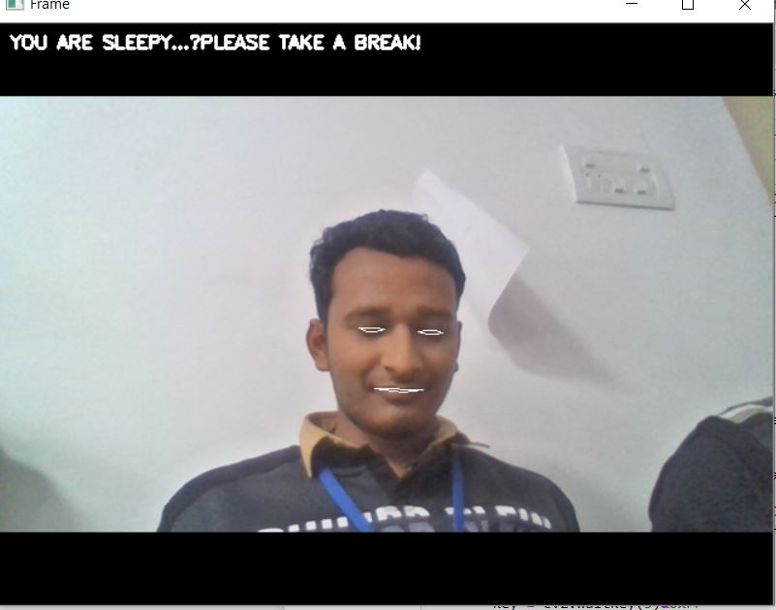
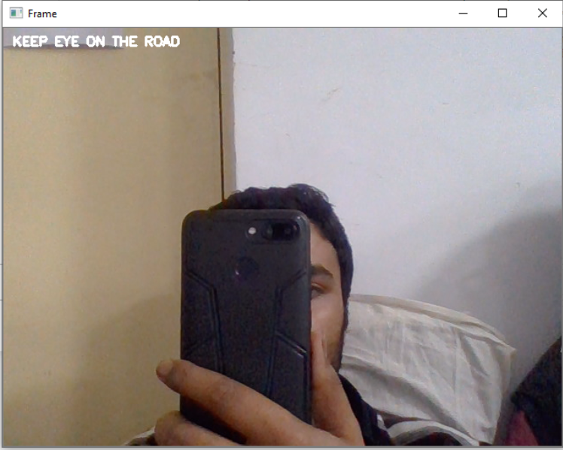
FEATURES:
• Detection of drowsiness • Detection of distraction • Audio feedback system • Different feedback based on type of distraction.(like using mobile phones)

Slide 7



TECHNOLOGY AND PRETRAINED MODEL:
OPENCV
PYTHON
HARRCASCADE CLASSIFIER
SHAPE PREDICTOR
DIFFERENT AUDIO

Slide 8




MODULES USED:
cv2
imutils
time
pygame
os
scipy
gtts
dlib
numpy

Slide 9
WORK FLOW
INSTALL NECESSARY MODULES
CREATING AND INSTALLING AUDIOS
RECOGNITION EMOTIONS AND DISTRACTION
DETECT EYE AND FACE USING HARCASCADE
MAKING CONTOUTRS OF EYE AND MOUTH
EMBEDDED DIFFERENT SEGMENTS INTO A SINGLE CODE

Slide 10
HARDWARE AND SOFTWARE REQURIMENT:
HARDWARE
1.PERSONAL COMPUTER
2.WEB CAMERA
3.ALARAM
SOFTWARE
1.PYTHON3
2.ANACONDA SOFTWARE

Slide 11

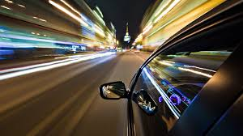
FUTURE SCOPE:
This project can be implemented for the feature of Seat Belt , Drink and Drive
This project can be integrated with car, so that automatic speed control can be imparted if the driver is found sleeping

Slide 12
DEVELOPING COST OF DROWSY DRIVER SYSTEM
Hardware Cost
WebCam - 1000
Alarm device – 500
Nano wire - 500
Special Hardware - 33000
Software Cost
Eye monitoring software cost - 10000
TOTAL ESTIMATED COST- 45000

Slide 13
THANK YOU

